Slide 1
Independent Project
ID-1035
Refreshable Braille Display
The Artisté
-Siddhant Chandorkar
-Sharanya Gupta S
-Sravanthi Reddy
-Nisha M
-Sai Ashish Jana
-Sujeeth Reddy

Slide 2
Acknowledgement
We are highly indebted to Dr Rupesh Ganpatrao Wandhare for his guidance and constant supervision as well as for providing necessary information regarding the project & also for his support in completing the project.
We would also like to express our special gratitude and thanks to the workshop staff for giving us timed attention.

Slide 3
Understanding the Problem
We live in a highly digital society. Most of us are constantly using our phones, laptops, computers, and tablets.
We use these devices to learn, to play games, to do work, to read, and to communicate and interact with each other.
But what if you're visually impaired? Are you able to participate in our digital society?
Our motive in this project is to address this issue in society!

Slide 4
Ideal Solution: Refreshable Braille Display
A refreshable Braille display comprises plurality of Braille dots that extend and retract arranged in Braille characters such that the Braille dots are operable as a personal computer monitor allowing a visually impaired to discern the information displayed thereon by reading the Braille characters formed by the extended Braille dots.
We developed an app which captures real time information(text) by scanning using the phone’s camera.
This data packet is then sent to the Arduino mega via bluetooth module.
The arduino reads the text, character by character based on the code written in the arduino IDE.
It then sends the signal to the steppers motors via driver IC.
The six stepper motors then rotate clockwise and counter clockwise based on the required combination as per the braille language.

Slide 5
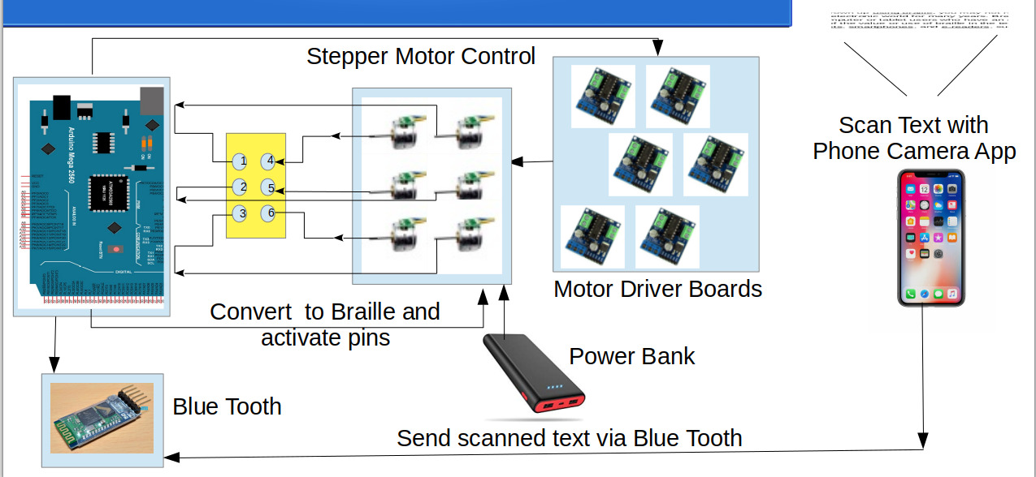
WORKING

Slide 6
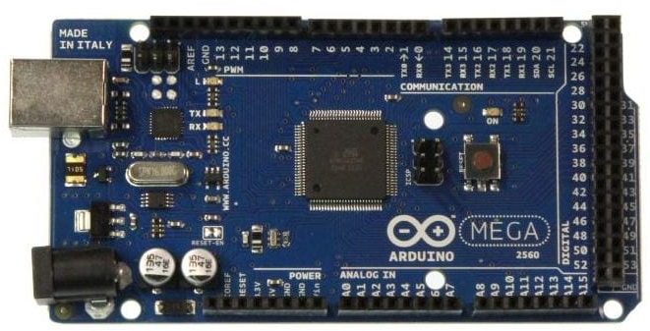
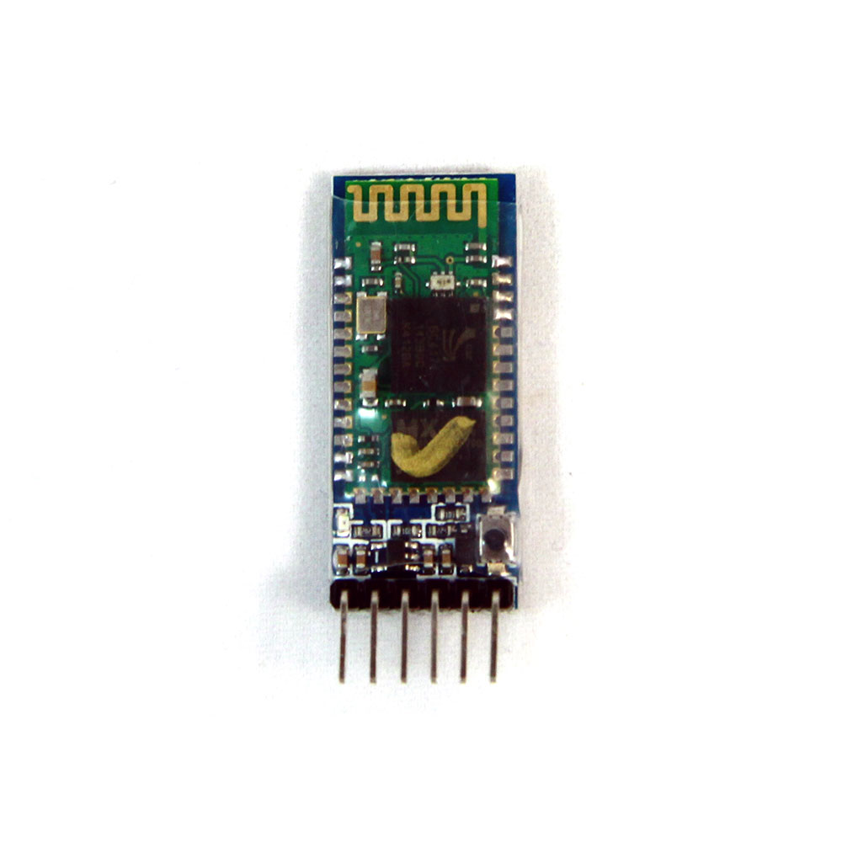
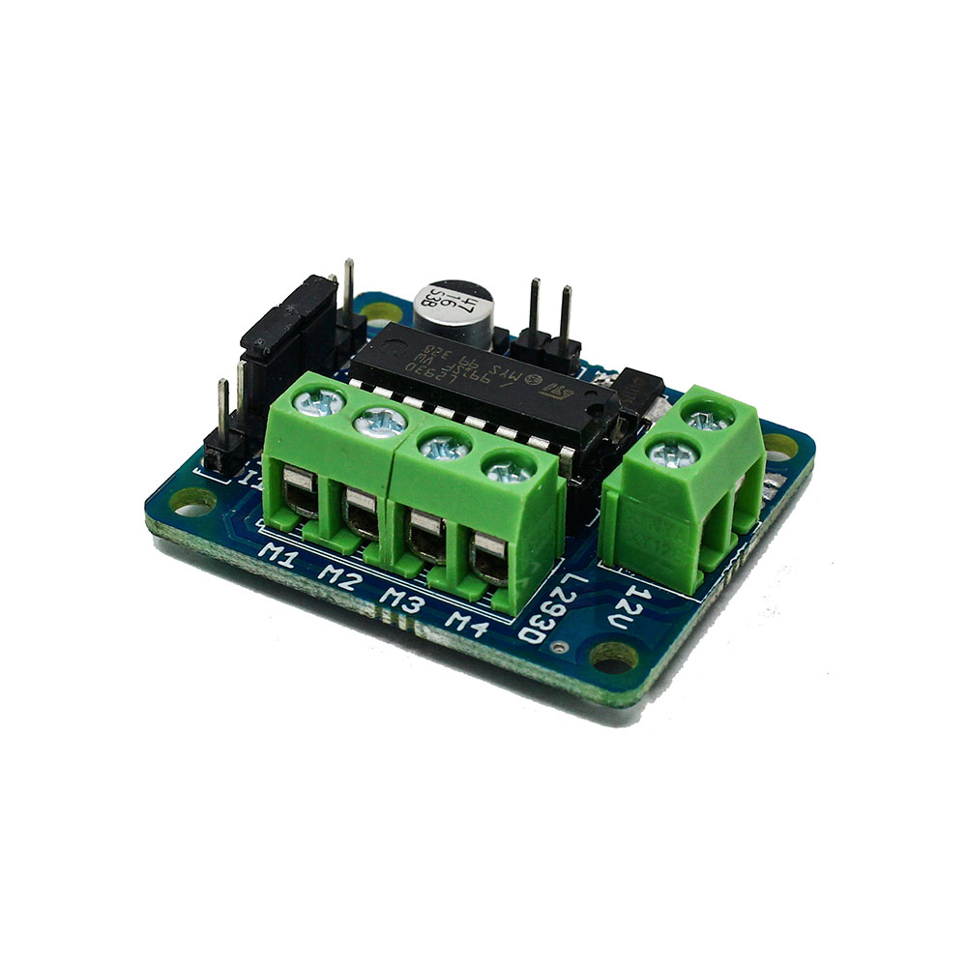
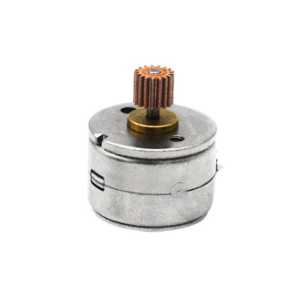
Components Used
Arduino Mega 2560
L293D Motor Driver IC
Mini Stepper Motors
HC05 Bluetooth Module
9V Battery
5V DC supply
Jumper Wires
Breadboard

Slide 7
What makes our project distinct?
We have tried to distinct our project making it cost and space effective so that it is conveniently used the visually impaired people.
Our project has been made cost effective by avoiding the usage of expense microcontrollers like raspberry pi and pi cameras. We instead are using simple mobile computational powers to achieve the task. Eg: Android mobile camera to scan the text.
This project has been made space effective by avoiding the usage of big actuators.Instead we are using mini stepper motors which rotate clockwise and counter clockwise making the braille dots extend and retract.

Slide 8
The Android App
The app we developed is basically designed to scan any text and send it to the Arduino Mega via bluetooth module.
This app consists of three activities coded to do the following:
1.MainActivity - Scans the text and calls the bluetooth activity.
2.BluetoothActivity -Discovers , pairs a device .
3.SendString-Stores the string temporarily and sends it to the arduino mega.

Slide 9
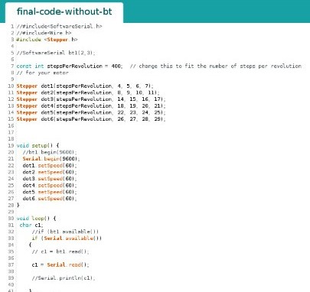
The arduino code
The code consists of switch cases for each alphabet which drives the stepper motors independently making them actuate according to the braille characters.

Slide 10
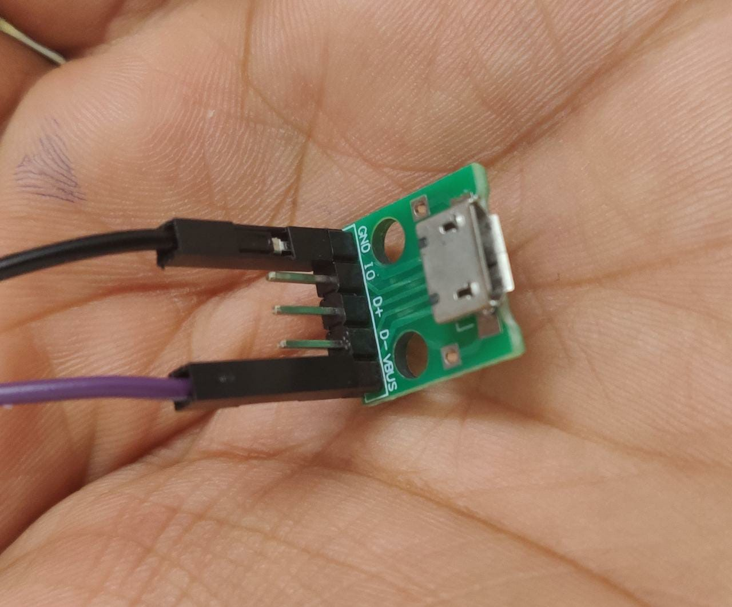
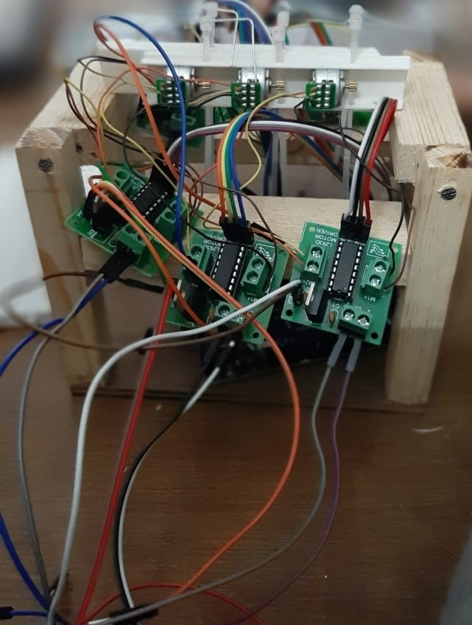
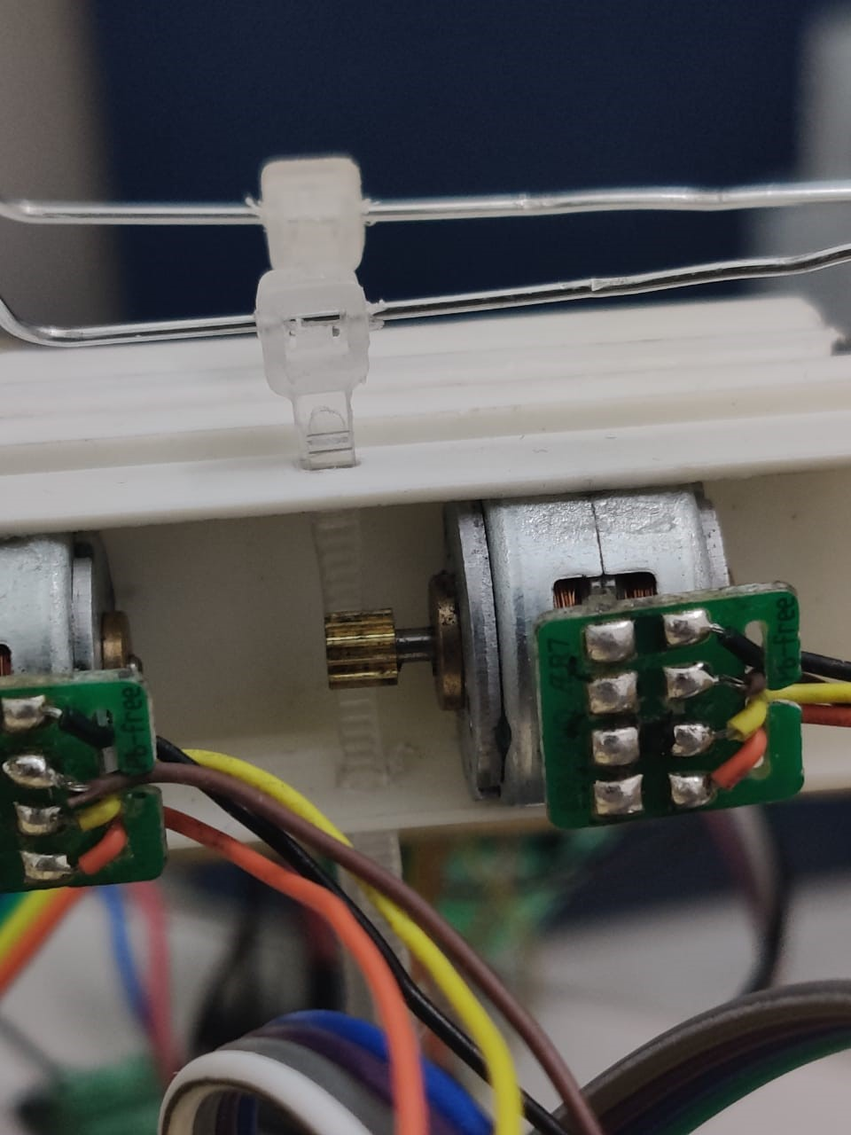
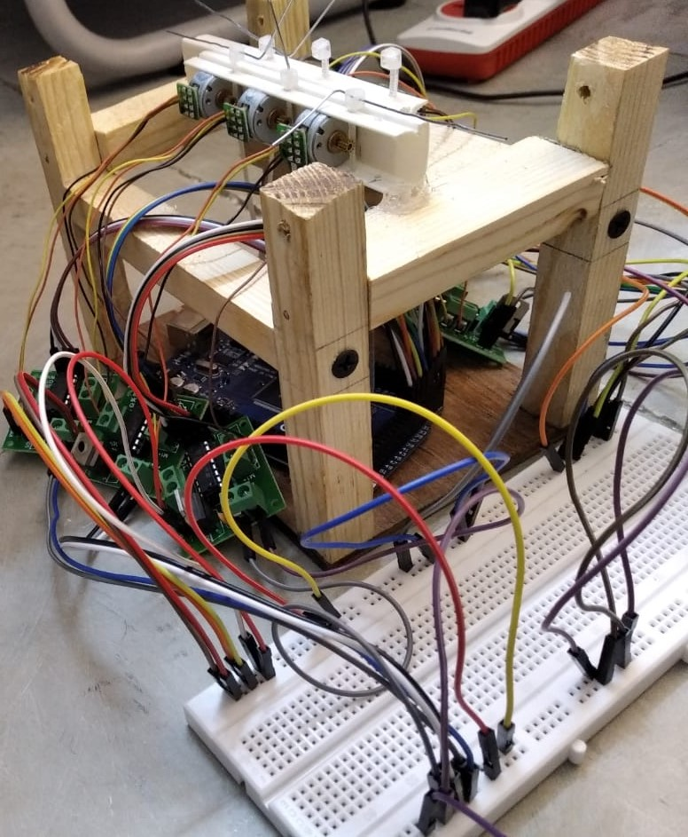
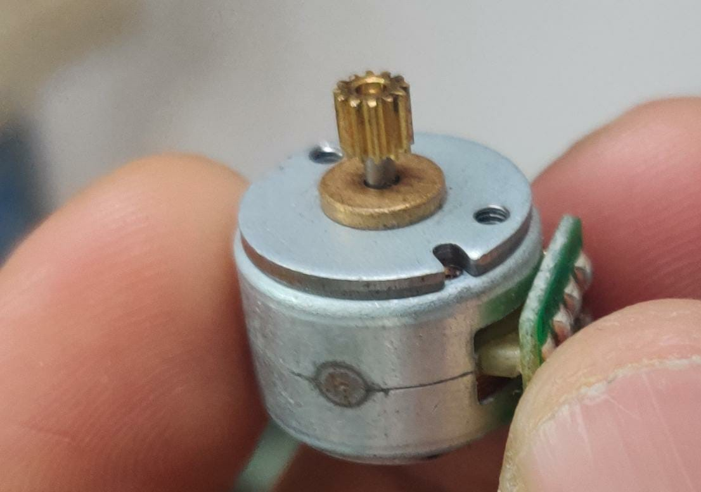
Mini stepper motor

Slide 11
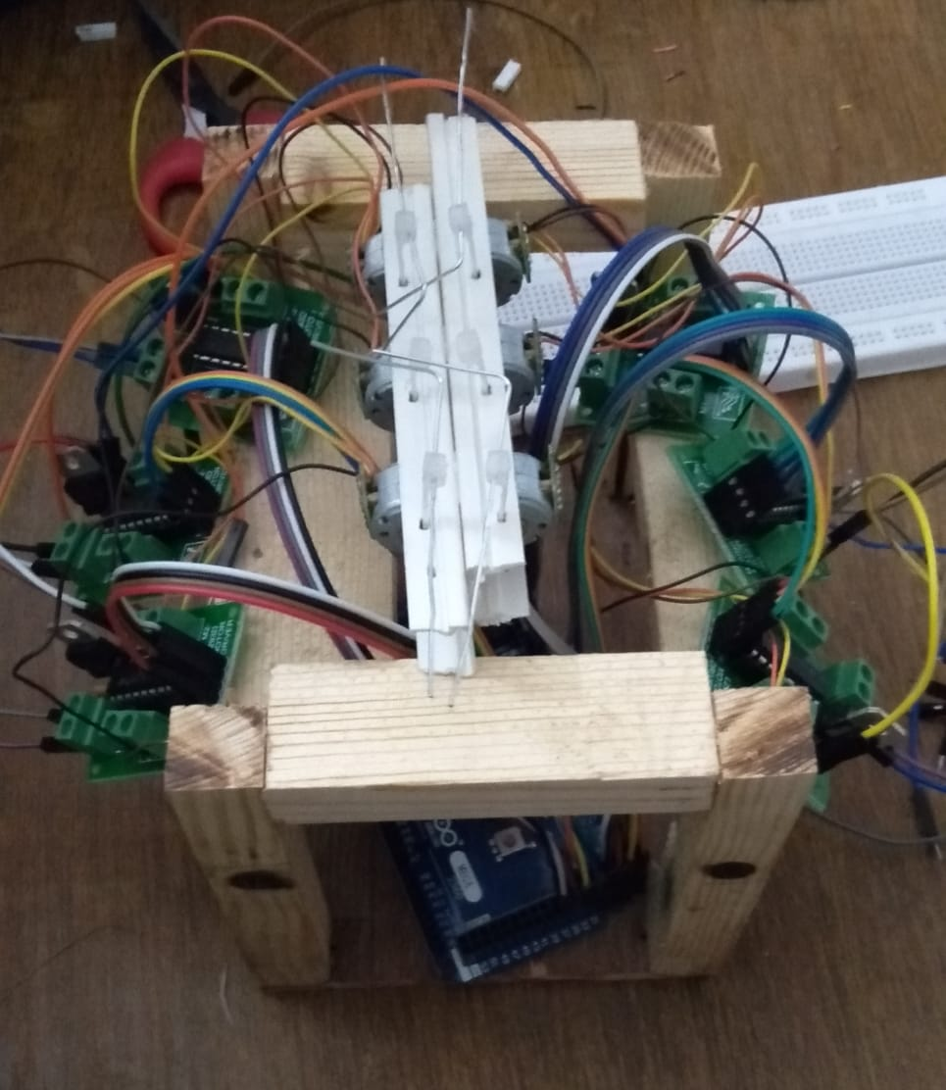
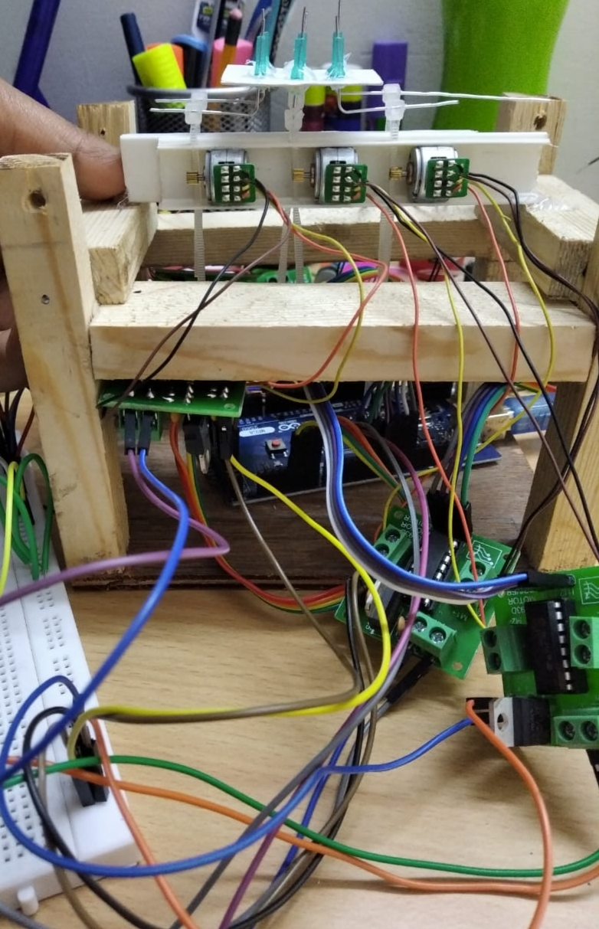

Slide 12
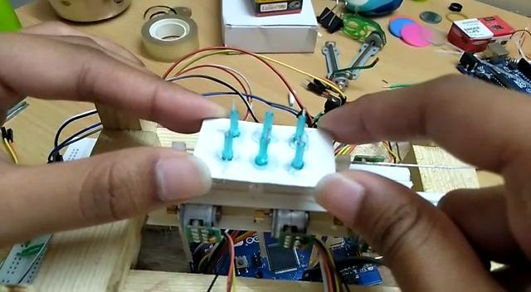

Slide 13
Extension of our idea developed
We can also help the visually impaired to navigate through the device with the current idea developed.
We can make the device more compact and portable into a glove using latest small motors and integrate it with AI which gives the visually impaired person real time updates about everything happening around. It make visually impaired more confident about his surroundings without the need of human assistance.

Slide 14
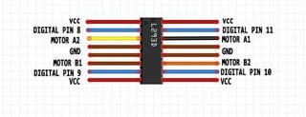
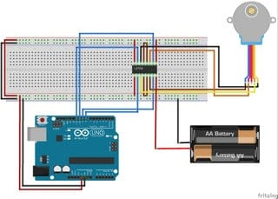
Circuit Diagrams

Slide 15
THANK YOU

